Slide 1
ARM TechCon 2015
Practical Development of Safe, Secure, Reliable Embedded Software
Pat Rogers, PhD
rogers@adacore.com
November 2015

Slide 2
The Future of Critical Software
Your car could crash
Your flight could crash
Your medical implant could fail
Your bank account could disappear
Your marriage could fail (No?
Et cetera
Ashley Madison…)
Notes:
For that matter, your bank account would disappear if your marriage fails… ☺
Malaysian airlines 777 incident

Slide 3
Buggy Code Is Not Inevitable
There’s no such thing as a silver bullet
But there are much better options available
We can produce highly-reliable software at a reasonable cost

Slide 4
A Better Way: SPARK 2014
A formally-defined programming language supporting static analysis
Specifically designed for high-integrity software
A set of tools to perform those analyses
Based on statically provable contracts + testing

Slide 5
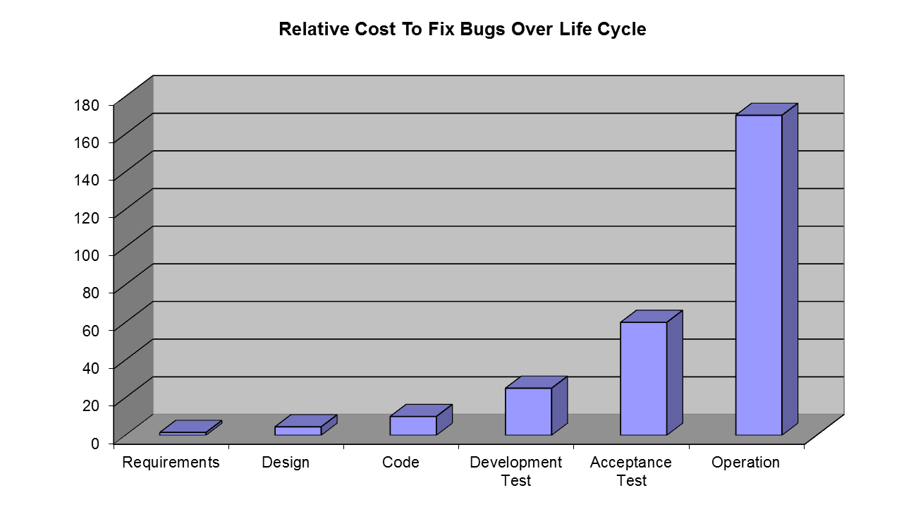
Why Static Analysis Saves Money
Shifts costs from later, expensive phases to earlier, cheaper phase
Source: Barry Boehm, Software Engineering Economics, Prentice Hall, 1981
Notes:
Source: Barry Boehm, Software Engineering Economics, Prentice Hall, 1981, pg. 40

Slide 6
How Does Formalism Shift Costs?
Bugs that testing would have caught may be caught earlier
Bugs that testing would have missed may be caught
Passing (nearly) all the tests the first time is cheaper…

Slide 7
Contracts
“Preconditions” specify caller obligations
“Postconditions” specify implementer guarantees
procedure Push (This : in out Stack; Value : Content) with
Pre => not Full (This),
Post => not Empty (This) and Top (This) = Value;
…
function Top (This : Stack) return Content;
function Full (This : Stack) return Boolean;
Requirement
Guarantee

Slide 8
DMA Device Driver Contract Example
type DMA_Status_Flag is
(FIFO_Error_Indicated,
Direct_Mode_Error_Indicated,
Transfer_Error_Indicated,
Half_Transfer_Complete_Indicated,
Transfer_Complete_Indicated);
procedure Clear_All_Status (Unit : in out DMA_Controller; Stream : DMA_Stream_Selector)
with Post =>
(for all Flag in DMA_Status_Flag => not Status_Indicated (Unit, Stream, Flag));
function Status_Indicated
(Unit : DMA_Controller;
Stream : DMA_Stream_Selector;
Flag : DMA_Status_Flag)
return Boolean;
Guarantees no flags remain set after call

Slide 9
What Can You Prove With It?
Data and Information flow
No uninitialized variables, unused assignments, etc.
Data only goes where you want it to go
Freedom from run-time errors
No buffer overflow, no numeric overflow, no divide by zero, no invalid array indexes, no null pointer deference, etc.
Functional correctness at unit level
Arbitrary security and safety properties
Notes:
See http://www.adacore.com/sparkpro/language-toolset
Data Flow Analysis
Detects common programming errors that can be the cause of insecurities or erroneous behaviour, including uninitialised variables and ineffective assignments. Advanced data flow analysis can be used to check that access to global variables conforms to contracts specified by a software architect, thereby ensuring that the software conforms to its architectural design.
Information Flow Analysis
For more critical applications, dependency contracts can be specified to constrain the information flow allowed in a program. Violations of these contracts - potentially representing violations of safety or security policies - can then be detected even before the code is compiled.
Absence of Run Time Exceptions
SPARK Pro can check that a program is free from run-time exceptions such as divide-by-zero, numeric overflow, buffer overflows or indexing an array out-of-bounds. The mathematical proof system on which SPARK Pro is based guarantees that this analysis is sound, so that even before a program is executed or tested or large class of potentially hard-to-detect errors can be eliminated from your software.
Property Checking
For more critical applications, key safety or security properties can be expressed in the contract notation that forms part of Ada 2012. Using a mathematically-sound proof system, the SPARK Pro toolset is able to automatically check that a program will satisfy these properties for all possible inputs and execution paths - as if the program had been exhaustively tested but without ever having to compile or run the code.
Functional Correctness
With its extended contract language, SPARK provides for fully comprehensive, formal specification of the required functional behaviour of a program ie. a specification of the Low-Level Requirements. Using the same proof system, the SPARK Pro tools will automatically prove that a program meets its functional specification, thus providing the highest possible level of assurance for the correct behaviour of critical systems.

Slide 10
Proving Functional Correctness Example
type Move_Result is (Full_Speed, Slow_Down, Keep_Going, Stop);
procedure Move
(Train : in Train_Id;
New_Position : in Train_Position;
Result : out Move_Result)
with
Global => (Input => Cur_Num_Trains,
In_Out => (Trains, Track_Signals)),
Pre => Train in 1 .. Cur_Num_Trains and then
Valid_Move (Trains (Train), New_Position) and then
One_Train_At_Most_Per_Track and then
Safe_Signaling,
Post => One_Train_At_Most_Per_Track and then
Safe_Signaling;

Slide 11
Why Doesn’t Everyone Use Formalism?
Your software development already does!
The ultimate product of software development is a precise, rigorous description of behavior
It’s machine code
Operational semantics defined by the target processor
So it’s not whether, but when to use formalism
Earlier in the life cycle is better

Slide 12
Really, Why Doesn’t Everybody Use It?
Perception that formal methods have “flopped” due to inability to prove entire programs correct
Fear of the mathematics
But the math is now hidden behind the tools
Now easy enough to adopt and use by regular teams

Slide 13


How Smart Do You Have To Be?
Too Much
Too Little
Just Right
Notes:
Inga is the only “normal” person in the bunch. She displays her intelligence and wits several times, for example regarding the revolving door candle control.

Slide 14
Sufficiently Easy to Adopt
Can do it gradually
SPARK is just Ada 2012!
Have some units in SPARK, others in Ada
Inside units, parts in SPARK and parts in Ada
Plenty of tool support
Based on GNAT projects
SPARK tools integrated in the IDEs

Slide 15
Sufficiently Easy to Use
Provides incremental benefits
Usable without up-front work (no contracts)
Increasing benefits with more contracts
Is highly interactive
Run at different levels of granularity (down to single line)
Run at different levels of analysis power
Get precise results in the IDE or command line
Get results’ explanations (paths, counterexamples)
Notes:
The command line case is important because that would be the usage for certification (at least once, at the end).

Slide 16
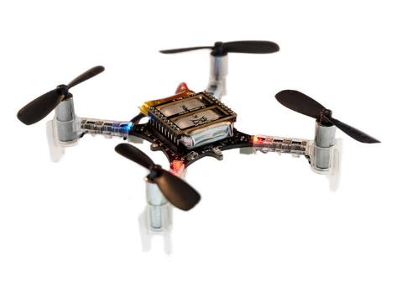
The Crazyflie 2.0 Example

Slide 17
Crazyflie 2.0 Dual MCU System Architecture
10 DOF IMU
3-axis accelerometer
3-axis gyro
3-axis magnetometer
pressure sensor
RF Power Amp.
I2C
nRF51822
16MHz Cortex M0
16KB RAM, 256KB FLASH
BLE and NRF Radio
STM32F405
168MHz Cortex M4
196KB RAM, 1MB FLASH
Flight Control
UART
PWM
Motors
I2C
Power
Expansion Port
EEPROM
Notes:
10 Degree of Freedom Inertial Measurement Unit
See https://www.bitcraze.io/2014/07/crazyflie-2-0-system-architecture/

Slide 18
MCU Responsibilities
nRF51822
STM32F405
On/Off logic
Power management
Master radio bootloader
Radio and BLE communication
Detect and check installed expansion boards
(Everything else…)
Sensor reading
Motor control
Flight control
Telemetry
Additional user development
Notes:
BLE: Bluetooth Low Energy

Slide 19

The Crazyflie 2.0 Challenge
1800 SLOC for stabilization in C
+ FreeRTOS for threading
+ …
SPARK
2014
Notes:
That’s Asok the intern

Slide 20

2 months later…
Re-written in Ada/SPARK
2100 SLOC in SPARK
proved no run-time errors!
+ FreeRTOS
+ …
1800 SLOC stabilization in C
+ FreeRTOS
+ …
Notes:
See blog.adacore.com/how-to-prevent-drone-crashes-using-spark

Slide 21
5 months later…
Re-written in Ada/SPARK
2100 SLOC in SPARK
proved no run-time errors
+ Ravenscar tasking
+ will prove no concurrency errors
1800 SLOC stabilization in C
+ FreeRTOS
+ …
Notes:
Not 100% complete -- no data logging, and various other minor things not implemented (e.g., doesn’t blink the green LED as the radio data packages are sent).

Slide 22
How Do The Implementations Compare?
He added drop recovery
But he didn’t implement data logging
Ada code size is slightly less (about 3K less)
Ada data size is much less (about 23K less)
Notes:
Current totals for Ada are 72,920 bytes of code and 81,024 bytes of RAM.
Current totals for C are 75,904 bytes of code and 104,000 bytes of RAM.

Slide 23
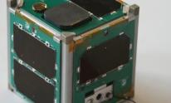
Lunar CubeSat
Created by students at Vermont Technical College
Launched into Earth orbit in 2013
One of the very few that works
Team selected for new version going to the Moon
Lunar IceCube
Notes:
Not just possible for a smart intern located at AdaCore
“Flying at a slightly higher altitude…”

Slide 24
MULTOS Certificate Authority Reliability
MULTOS is an operating system for smartcards
100,000 lines of SPARK code
Only 4 defects reported 1 year after delivery
0.04 per KSLOC
Corrected under warranty (!)
Industry standard is 5 defects per 1,000 lines
Thus approximately 500 defects expected
Ultra-high reliability achieved
Notes:
Thus the SPARK defect rate was 0.04 per KSLOC.
Page 24

Slide 25
MULTOS CA Productivity
28 lines of code per day
Fully documented, tested, everything
Industry standard is 10 lines of code per day
Very high levels of productivity
Notes:
Page 25

Slide 26

iFACTS
“interim Future Area Controls Tools Support”
The UK’s next generation ATC system, online 2011
Tools for trajectory prediction, conflict detection and monitoring aids
Includes over 200K lines of SPARK source code
Proven exception-free

Slide 27

Vehicle Component Research Project
By TOYOTA InfoTechnology Center (ITC)
To show that software requirements can be transformed into an implementation proven to be free of run-time errors
Currently underway
Notes:
Not just toy projects

Slide 28
Multiple Use Cases (1/2)
A safe coding standard for critical software
Increases portability across compilers/platforms
Addressing data and control coupling
Proving absence of run-time errors (“AoRTE”)
Requires few contracts
Typically 95% - 98% proved
Proof can be completed by testing

Slide 29
Multiple Use Cases (2/2)
Safe removal of run-time checks
Prove correct integration between components
Replaces defensive coding
Simple contracts are needed
Prove functional correctness
Replaces unit testing
More complex contracts are needed

Slide 30
Combining Proof and Test
Because not everything can be proved…
Focus test coverage on unproven runtime error checks
At the level of individual subprograms, proven routines can call tested routines and vice versa
During integration tests, proofs replace unit tests
Contracts already express what the unit tests would test

Slide 31
Concluding Remarks
How safe/secure/reliable must your software be?
You can do anything with any language – but at what cost?
High reliability at reasonable cost is demonstrable now
You don’t need a new team to get there
Come drop a Crazyflie at the AdaCore booth

